Slide 1
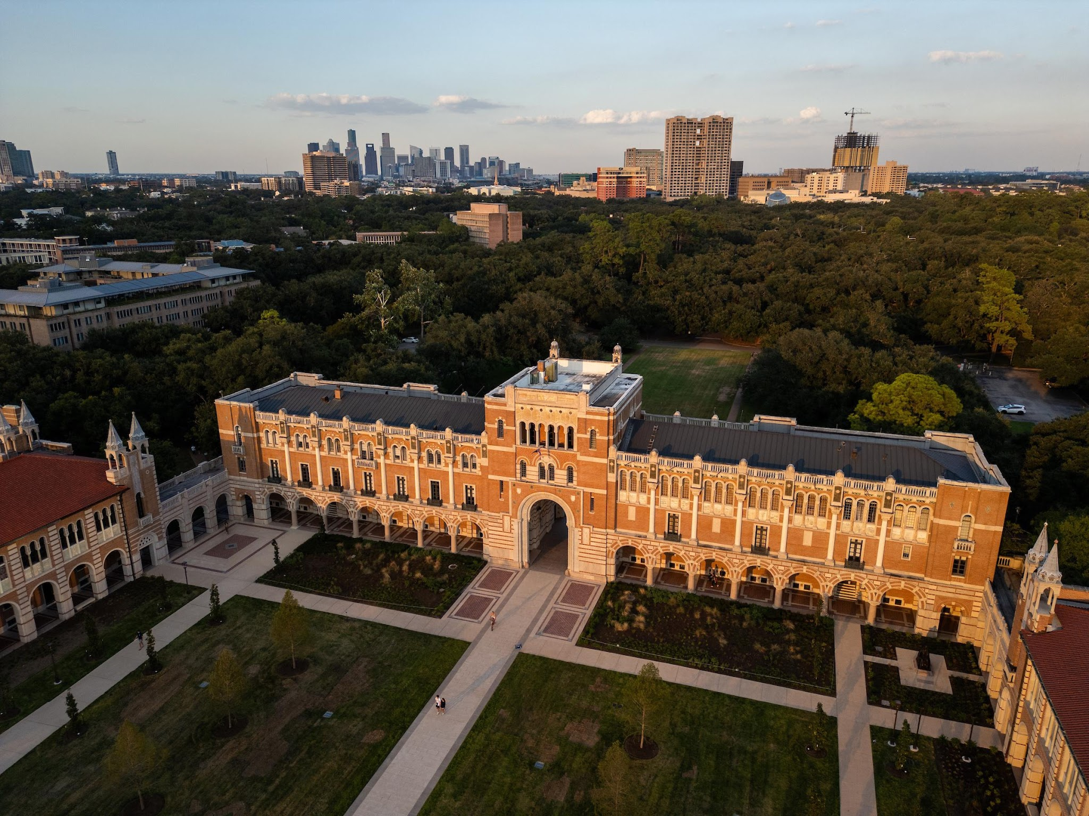

Convergence Explainability in Text Classification
Comp 640 003
Explainable NLP
Ryan Li

Slide 2
1:Introduction
Deep Neural Networks (DNNs) are widely applied many fields such as CV, NLP…
The optimization and evaluation of DNN models convergence are in an end-to-end fashion, treating the entire model as a singular black box.
Overfitting vs Underfitting
1

Slide 3
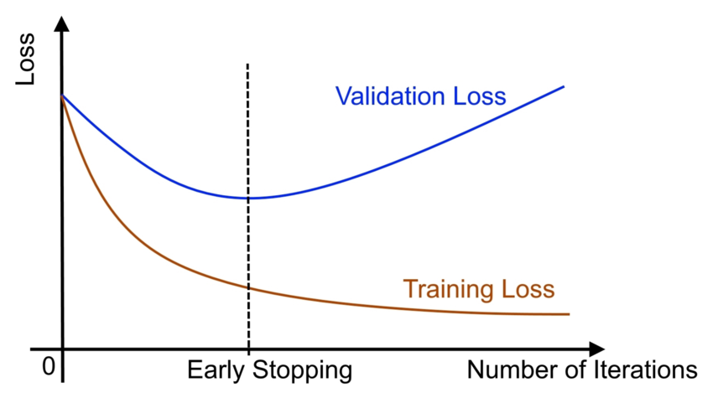
1:Introduction
How to evaluate the convergence degree of DNNs?
Examining Loss and Accuracy in Train and Validation set
2

Slide 4
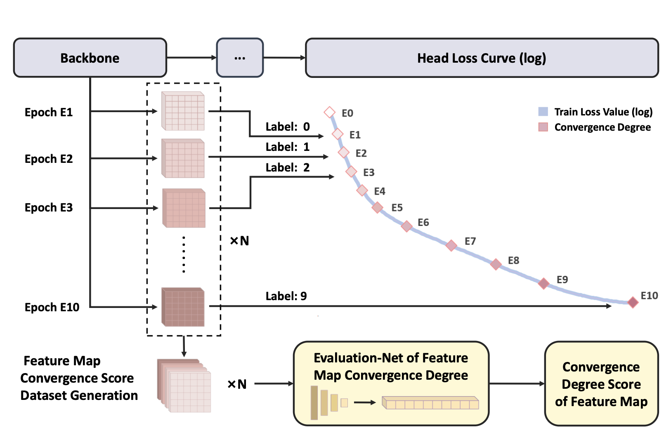
2:Related Work
FCME:
This work propose a Evaluation method in Image classification task in Computer Vision
Zhang, L., Chen, C., He, L., & Li, K. (2024, September). Feature map convergence evaluation for functional module. In 2024 IEEE 27th International Conference on Intelligent Transportation Systems (ITSC) (pp. 864-869). IEEE.
3

Slide 5
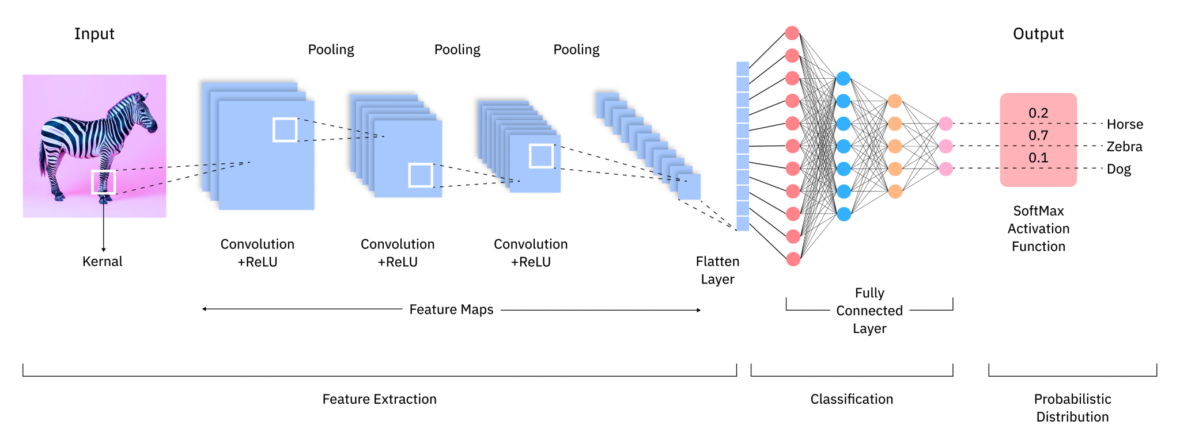
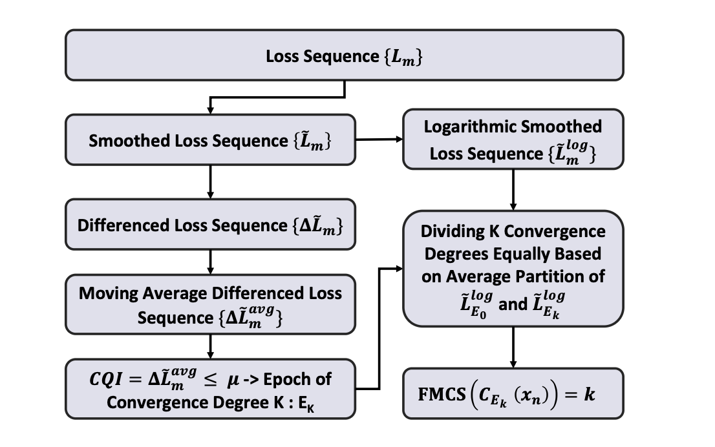
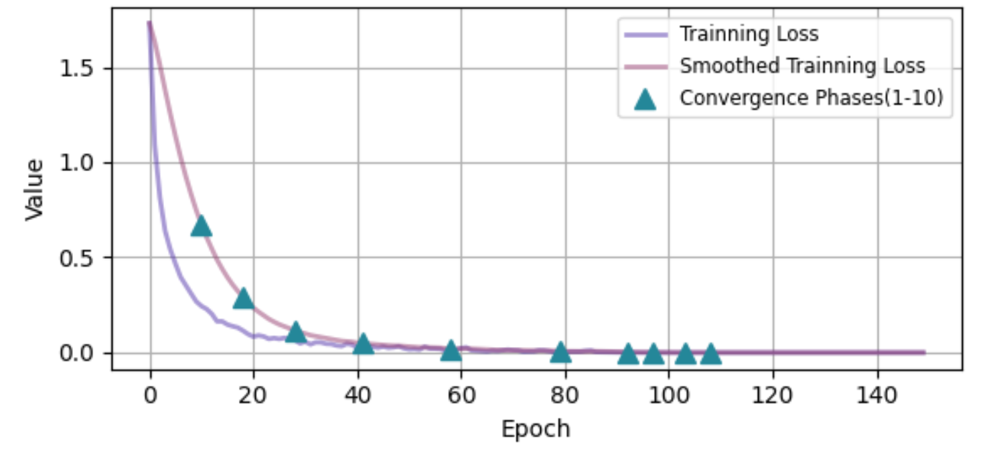
2:Related Work
Freeze
Train a New NN
Predict Convergence Stage
0.1.2.3.4.5….
4

Slide 6
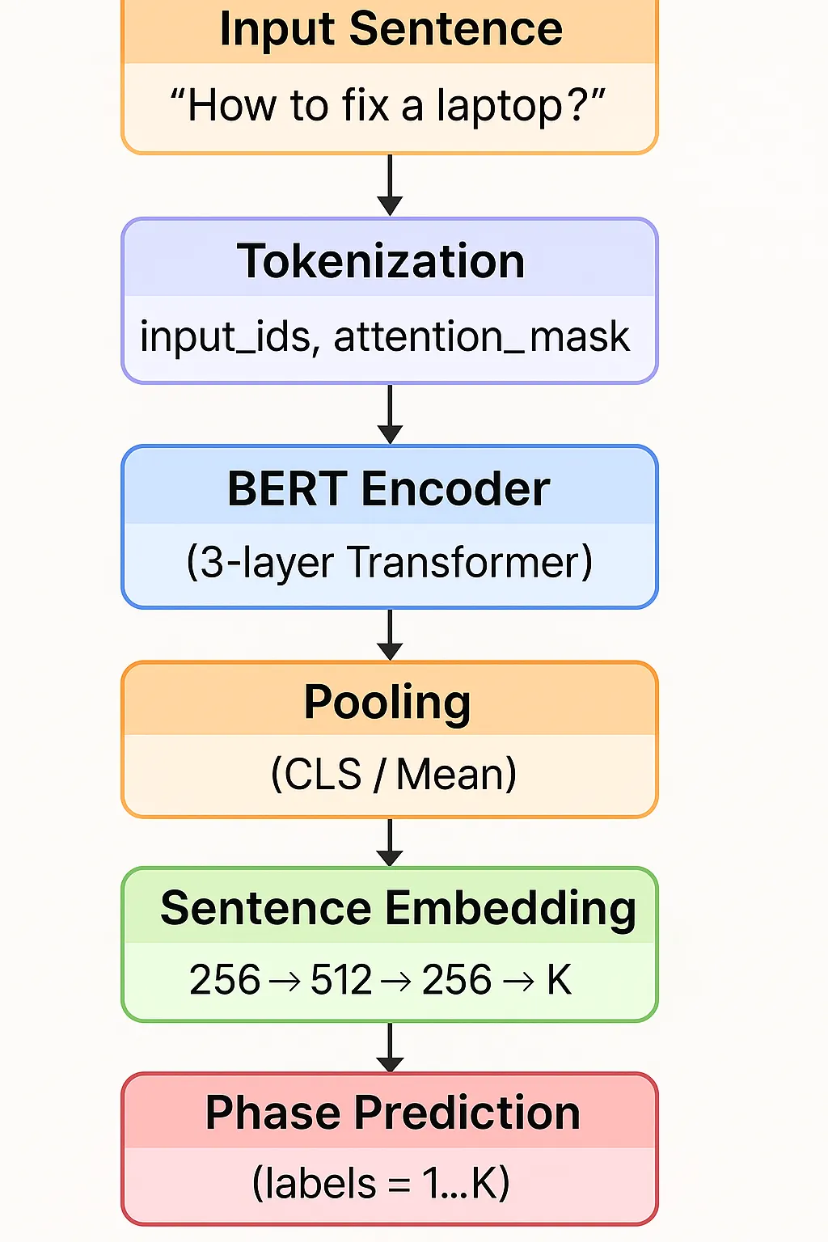
3:Methodology
Transform to Text Classification Task
Text Classification Pipeline Can also be Modularized
Tokenize
BERT Embedding(Feature Extraction)
Pooling & Classification Head
Use the Last Layer of MLP block then do a Pooling to get Sentence Embedding
Train a NN(MLP) to predict convergence stage
5

Slide 7
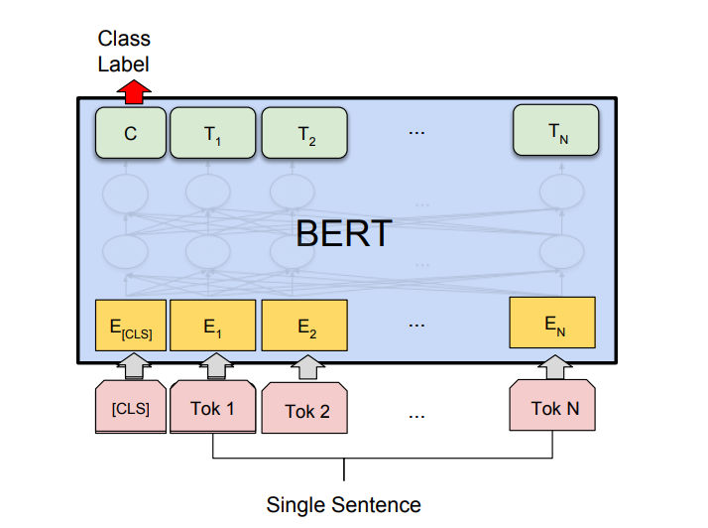
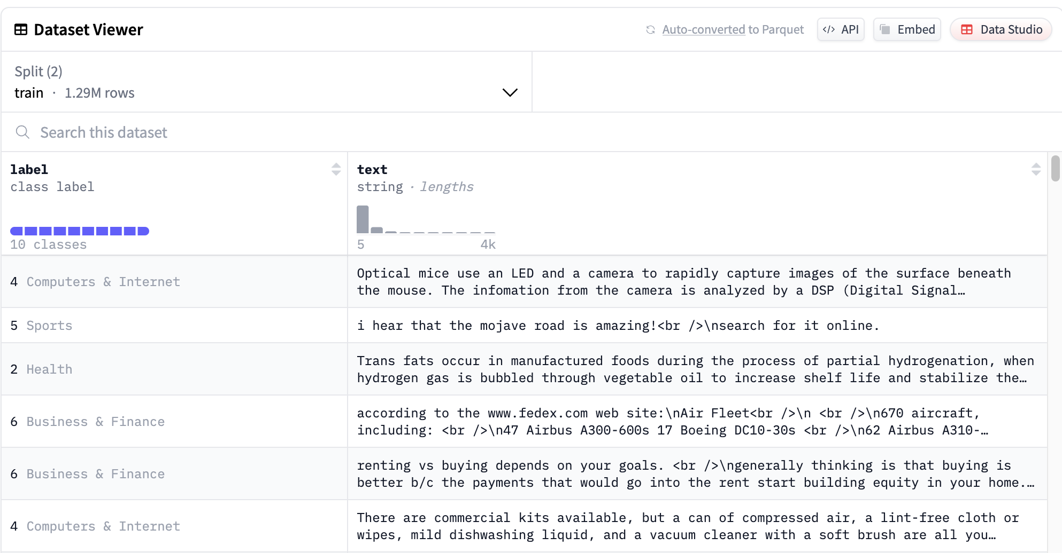
4:Models and Datasets
Models:
Transformer Base ⇒ BERT
Encoder-only, for classification task
Dataset:
Image Classification ⇒Yahoo
6

Slide 8

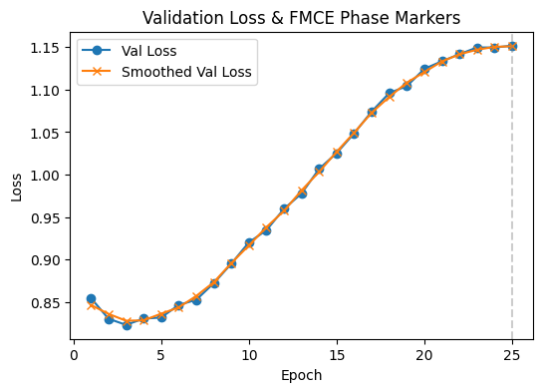
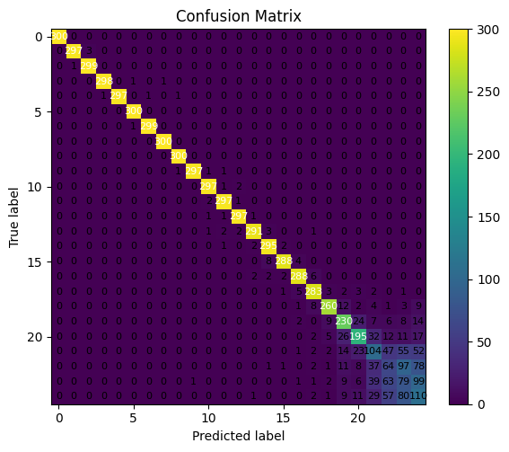
5:Experiments
Setup – Google Colab, T4
Spilt Yahoo
Train BERT(Mini) for 25 Epoch,
  Save Checkpoints and Loss
Construct Convergence Dataset
  Input: Sentence Embedding
  Output: Coverage stage(1-5)
Train MLP to Predict Coverage stage
  Result: Test Acc : 0.8487
Colab always Disconnected😭, Not reach the best result yet…
7

Slide 9
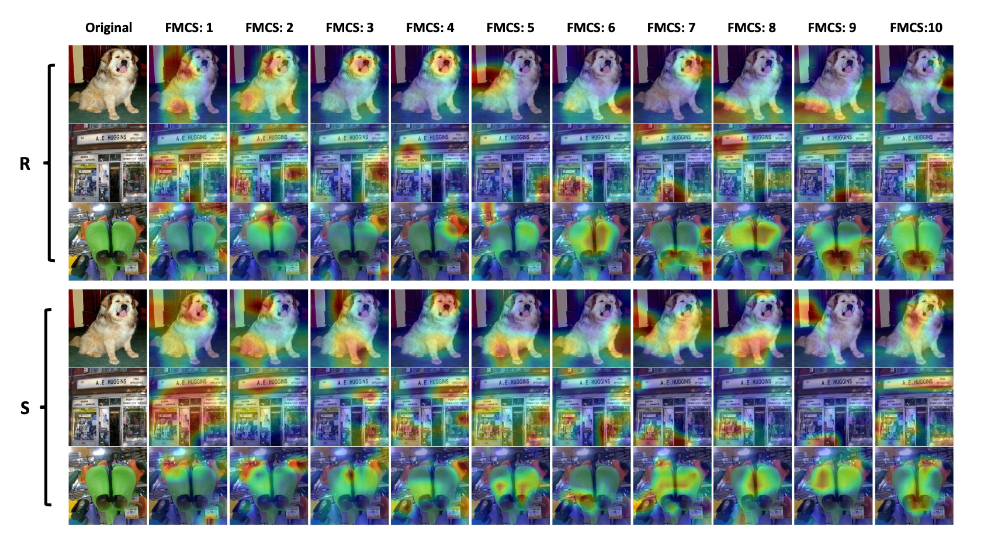
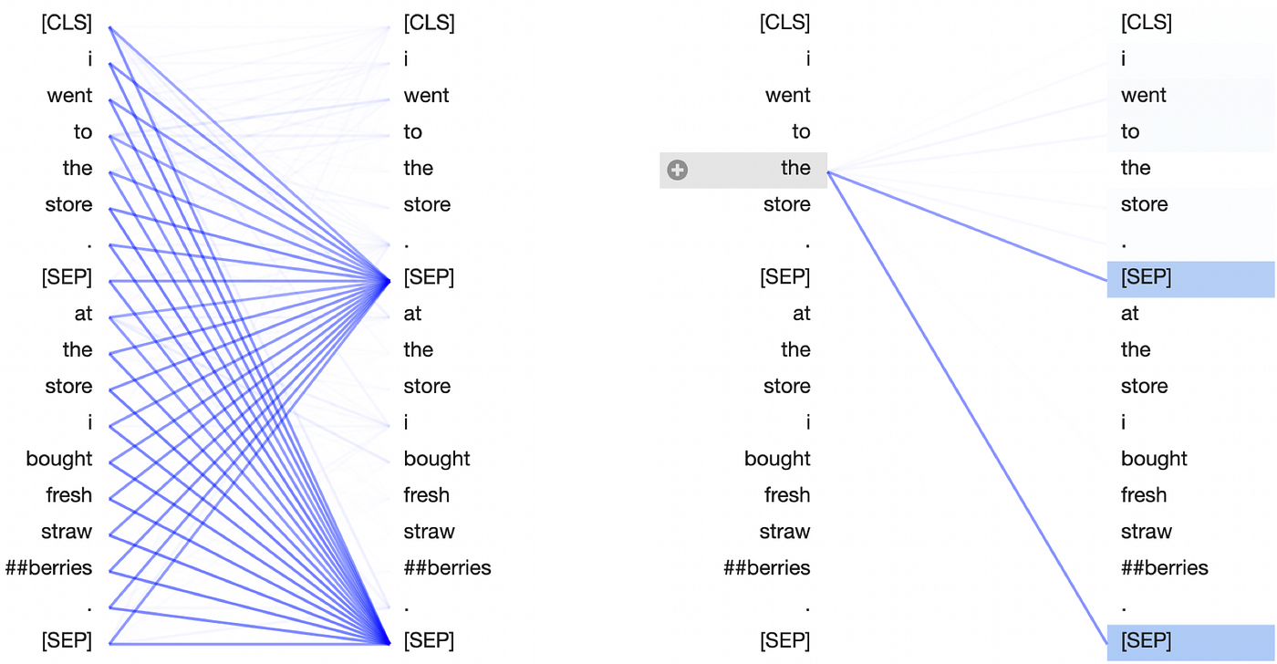
6: Future Work & Discussion
Previous Work used Visualization tool in CV to exam result
Visualization for BERT like BertViz Can be added
Zhang, L., Chen, C., He, L., & Li, K. (2024, September). Feature map convergence evaluation for functional module. In 2024 IEEE 27th International Conference on Intelligent Transportation Systems (ITSC) (pp. 864-869). IEEE.
8

Slide 10
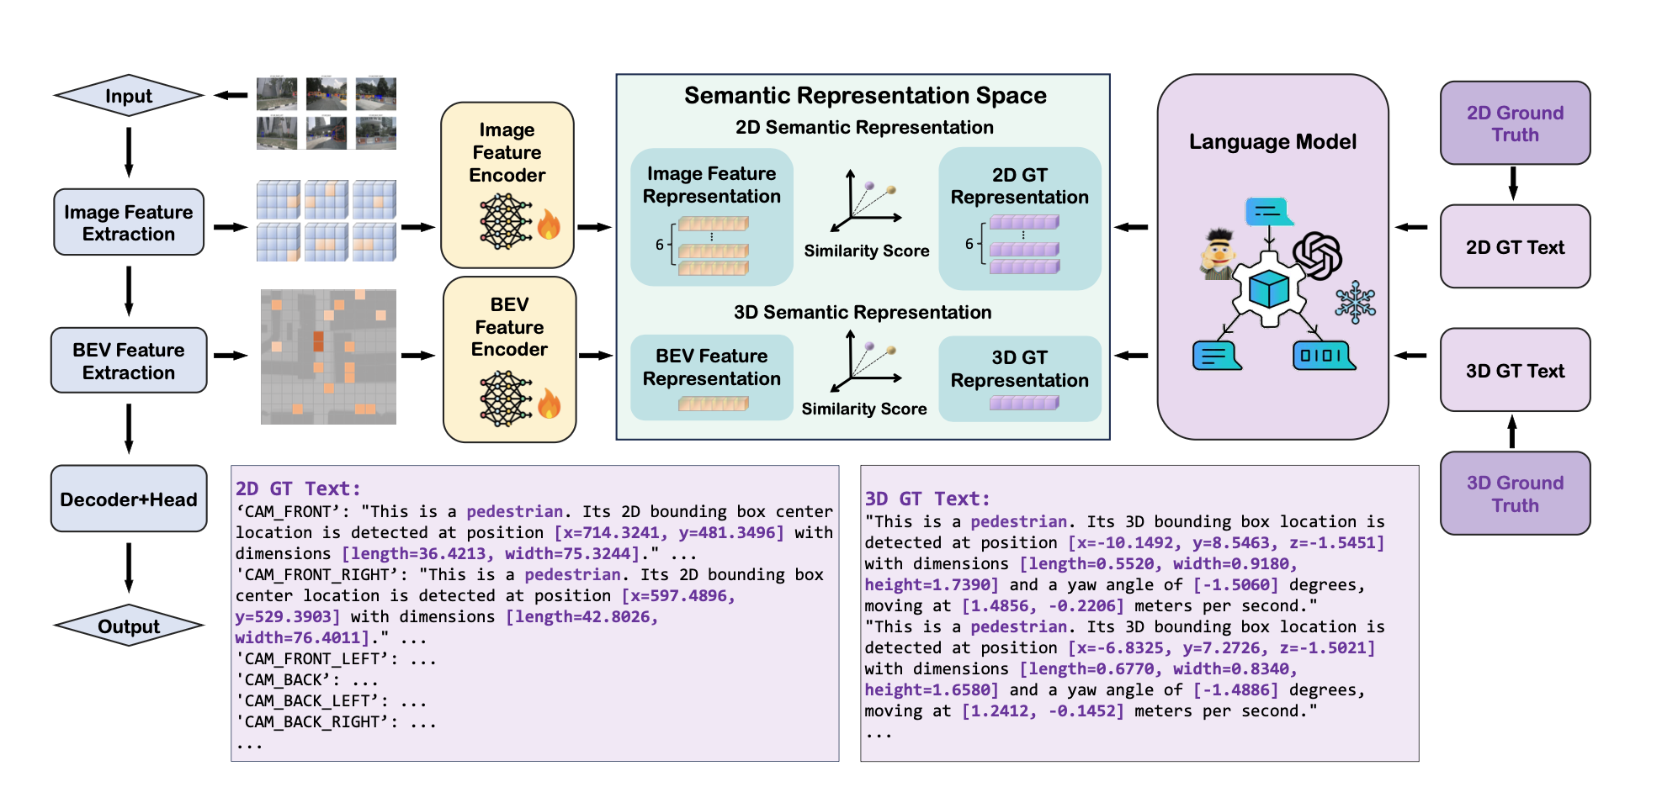
6:Future Work & Discussion
2. The Author use Framework to Evaluation some Harder Task like VLM
Train or Fine-tuning a LLM is very expensive, maybe some task such LM training or RL Fine-tuning can be discussed
Zhang, L., Ding, X., Dai, Y., He, L., & Li, K. (2025, May). Unveiling the Black Box: Independent Functional Module Evaluation for Bird's-Eye-View Perception Model. In 2025 IEEE International Conference on Robotics and Automation (ICRA) (pp. 7305-7311). IEEE.
9

Slide 11
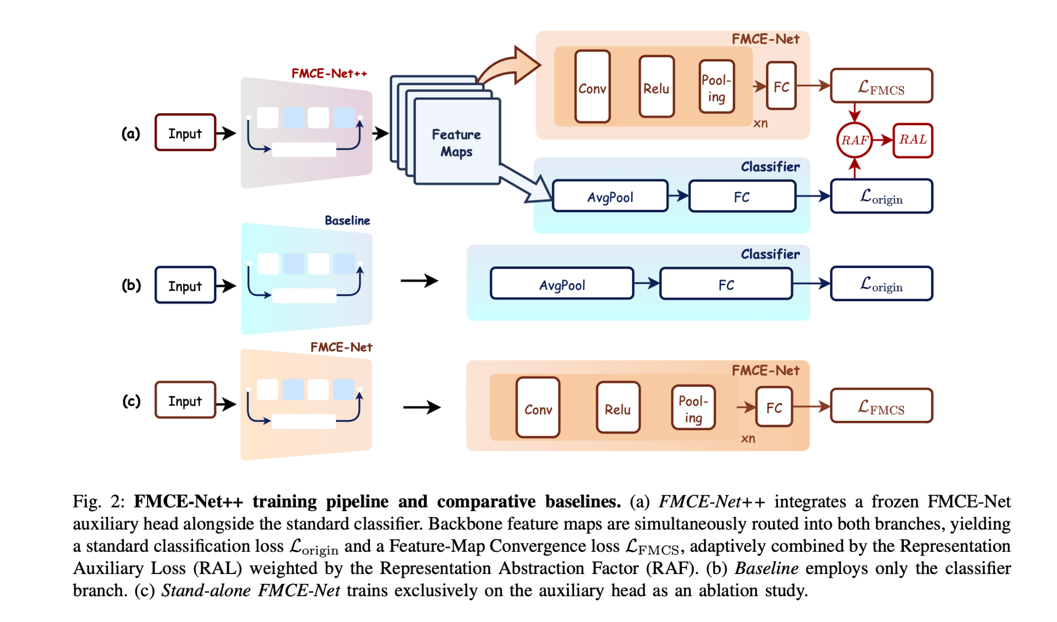
6:Future Work & Discussion
3. The Author use this loss to accelerate training in CV
Zhu, Z., Huang, R., & He, L. (2025). FMCE-Net++: Feature Map Convergence Evaluation and Training. arXiv preprint arXiv:2508.06109.
10

Slide 12
References
Zhang, L., Chen, C., He, L., & Li, K. (2024, September). Feature map convergence evaluation for functional module. In 2024 IEEE 27th International Conference on Intelligent Transportation Systems (ITSC) (pp. 864-869). IEEE.
Zhu, Z., Huang, R., & He, L. (2025). FMCE-Net++: Feature Map Convergence Evaluation and Training. arXiv preprint arXiv:2508.06109.
Zhang, L., Ding, X., Dai, Y., He, L., & Li, K. (2025, May). Unveiling the Black Box: Independent Functional Module Evaluation for Bird's-Eye-View Perception Model. In 2025 IEEE International Conference on Robotics and Automation (ICRA) (pp. 7305-7311). IEEE.
Devlin, J., Chang, M. W., Lee, K., & Toutanova, K. (2019, June). Bert: Pre-training of deep bidirectional transformers for language understanding. In Proceedings of the 2019 conference of the North American chapter of the association for computational linguistics: human language technologies, volume 1 (long and short papers) (pp. 4171-4186).
11

Slide 13
THANK YOU
Ryan Li

